Slide 1
Types and
Parametric Polymorphism
CS 345
Vitaly Shmatikov
slide <number>

Slide 2
Reading Assignment
Mitchell, Chapter 6
C Reference Manual, Chapters 5 and 6
slide <number>

Slide 3
Type
A type is a collection of computable values that share some structural property
Examples
  Integers
  Strings
  int → bool
  (int → int) →bool
“Non-examples”
  {3, true, λx.x}
  Even integers
  {f:int → int | if x>3 then f(x) > x*(x+1)}
Distinction between sets that are types and sets that are not types is language-dependent
slide <number>

Slide 4
Uses for Types
Program organization and documentation
  Separate types for separate concepts
    Represent concepts from problem domain
  Indicate intended use of declared identifiers
    Types can be checked, unlike program comments
Identify and prevent errors
  Compile-time or run-time checking can prevent meaningless computations such as 3 + true - “Bill”
Support optimization
  Example: short integers require fewer bits
  Access record component by known offset
slide <number>

Slide 5
Operations on Typed Values
Often a type has operations defined on values of this type
  Integers: + - / * < > … Booleans: ∧ ∨ ¬ …
Set of values is usually finite due to internal binary representation inside computer
  32-bit integers in C: –2147483648 to 2147483647
  Addition and subtraction may overflow the finite range, so sometimes a + (b + c) ≠ (a + b) + c
  Exceptions: unbounded fractions in Smalltalk, unbounded Integer type in Haskell
  Floating point problems
slide <number>

Slide 6
Type Errors
Machine data carries no type information
  01000000010110000000000000000000 means…
  Floating point value 3.375? 32-bit integer 1,079,508,992? Two 16-bit integers 16472 and 0? Four ASCII characters @ X NUL NUL?
A type error is any error that arises because an operation is attempted on a value of a data type for which this operation is undefined
  Historical note: in Fortran and Algol, all of the types were built in. If needed a type “color,” could use integers, but what does it mean to multiply two colors?
slide <number>

Slide 7
Static vs. Dynamic Typing
Type system imposes constraints on use of values
  Example: only numeric values can be used in addition
  Cannot be expressed syntactically in EBNF
Language can use static typing
  Types of all variables are fixed at compile time
  Example?
… or dynamic typing
  Type of variable can vary at run time depending on value assigned to this variable
  Example?
slide <number>

Slide 8
Strong vs. Weak Typing
A language is strongly typed if its type system allows all type errors in a program to be detected either at compile time or at run time
  A strongly typed language can be either statically or dynamically typed!
Union types are a hole in the type system of many languages (why?)
Most dynamically typed languages associate a type with each value
slide <number>

Slide 9
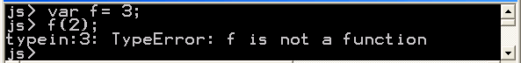
Compile- vs. Run-Time Checking
Type-checking can be done at compile time
  Examples: C, ML f(x) must have f : A → B and x : A
… or run time
  Examples: Perl, JavaScript
Java does both
Basic tradeoffs
  Both prevent type errors
  Run-time checking slows down execution
  Compile-time checking restricts program flexibility
    JavaScript array: elements can have different types
    ML list: all elements must have same type
Which gives better
programmer diagnostics?
slide <number>

Slide 10
Expressiveness vs. Safety
In JavaScript, we can write function like
  function f(x) { return x < 10 ? x : x(); }
  Some uses will produce type error, some will not
Static typing always conservative
  if (big-hairy-boolean-expression)
  then f(5);
  else f(10);
  Cannot decide at compile time if run-time error will occur, so can’t define the above function
slide <number>

Slide 11
Relative Type Safety of Languages
Not safe: BCPL family, including C and C++
  Casts, pointer arithmetic
Almost safe: Algol family, Pascal, Ada
  Dangling pointers.
    Allocate a pointer p to an integer, deallocate the memory referenced by p, then later use the value pointed to by p
    No language with explicit deallocation of memory is fully type-safe
Safe: Lisp, ML, Smalltalk, JavaScript, and Java
  Lisp, Smalltalk, JavaScript: dynamically typed
  ML, Java: statically typed
slide <number>

Slide 12
Enumeration Types
User-defined set of values
  enum day {Monday, Tuesday, Wednesday,
  Thursday, Friday, Saturday, Sunday};
  enum day myDay = Wednesday;
  In C/C++, values of enumeration types are represented as integers: 0, ..., 6
More powerful in Java:
  for (day d : day.values())
  System.out.println(d);
slide <number>

Slide 13
Pointers
C, C++, Ada, Pascal
Value is a memory address
  Remember r-values and l-values?
Allows indirect referencing
Pointers in C/C++
  If T is a type and ref T is a pointer:
  & : T → ref T * : ref T → T *(&x) = x
Explicit access to memory via pointers can result in erroneous code and security vulnerabilities
slide <number>

Slide 14
Arrays
Example: float x[3][5];
Indexing []
  Type signature: T[ ] x int → T
  In the above example, type of x: float[ ][ ],
  type of x[1]: float[ ], type of x[1][2]: float
Equivalence between arrays and pointers
  a = &a[0]
  If either e1 or e2 is type: ref T,
  then e1[e2] = *((e1) + (e2))
  Example: a is float[ ] and i int, so a[i] = *(a + i)
slide <number>

Slide 15
Strings
Now so fundamental, directly supported by languages
C: a string is a one-dimensional character array terminated by a NULL character (value = 0)
Java, Perl, Python: a string variable can hold an unbounded number of characters
Libraries of string operations and functions
  Standard C string libraries are unsafe!
slide <number>

Slide 16
Structures
Collection of elements of different types
  Not in Fortran, Algol 60, used first in Cobol, PL/I
  Common to Pascal-like, C-like languages
  Omitted from Java as redundant
struct employeeType {
char name[25];
int age;
float salary;
};
struct employeeType employee;
...
employee.age = 45;
slide <number>

Slide 17
Unions
union in C, case-variant record in Pascal
Idea: multiple views of same storage
type union =
record
case b : boolean of
true : (i : integer);
false : (r : real);
end;
var tagged : union;
begin tagged := (b => false, r => 3.375);
put(tagged.i); -- error
slide <number>

Slide 18
Recursive Datatypes
data Value = IntValue Integer | FloatValue Float |
BoolValue Bool | CharValue Char
deriving (Eq, Ord, Show)
data Expression = Var Variable | Lit Value |
Binary Op Expression Expression |
Unary Op Expression
deriving (Eq, Ord, Show)
type Variable = String
type Op = String
type State = [(Variable, Value)]
slide <number>

Slide 19
Functions as Types
Pascal example:
  function newton(a, b: real; function f: real): real;
  Declares that f returns a real value, but the arguments to f are unspecified
Java example:
  public interface RootSolvable {double valueAt(double x);}
  public double Newton(double a, double b, RootSolvable f);
slide <number>

Slide 20
Type Equivalence
Pascal Report:
  “The assignment statement serves to replace the current value of a variable with a new value specified as an expression ... The variable (or the function) and the expression must be of identical type”
Nowhere does it define identical type
  Which of the following types are equivalent?
  struct complex { float re, im; };
  struct polar { float x, y; };
  struct { float re, im; } a, b;
  struct complex c,d; struct polar e; int f[5], g[10];
slide <number>

Slide 21
Subtypes
A subtype is a type that has certain constraints placed on its values or operations
Can be directly specified in some languages (Ada)
subtype one_to_ten is Integer range 1 .. 10;
Will talk more about subtyping when talking about object-oriented programming
slide <number>

Slide 22
Overloading
An operator or function is overloaded when its meaning varies depending on the types of its operands or arguments or result
Examples:
  Addition: integers and floating-point values
    Can be mixed: one operand an int, the other floating point
    Also string concatenation in Java
  Class PrintStream in Java:
  print, println defined for boolean, char, int, long, float, double, char[ ], String, Object
slide <number>

Slide 23
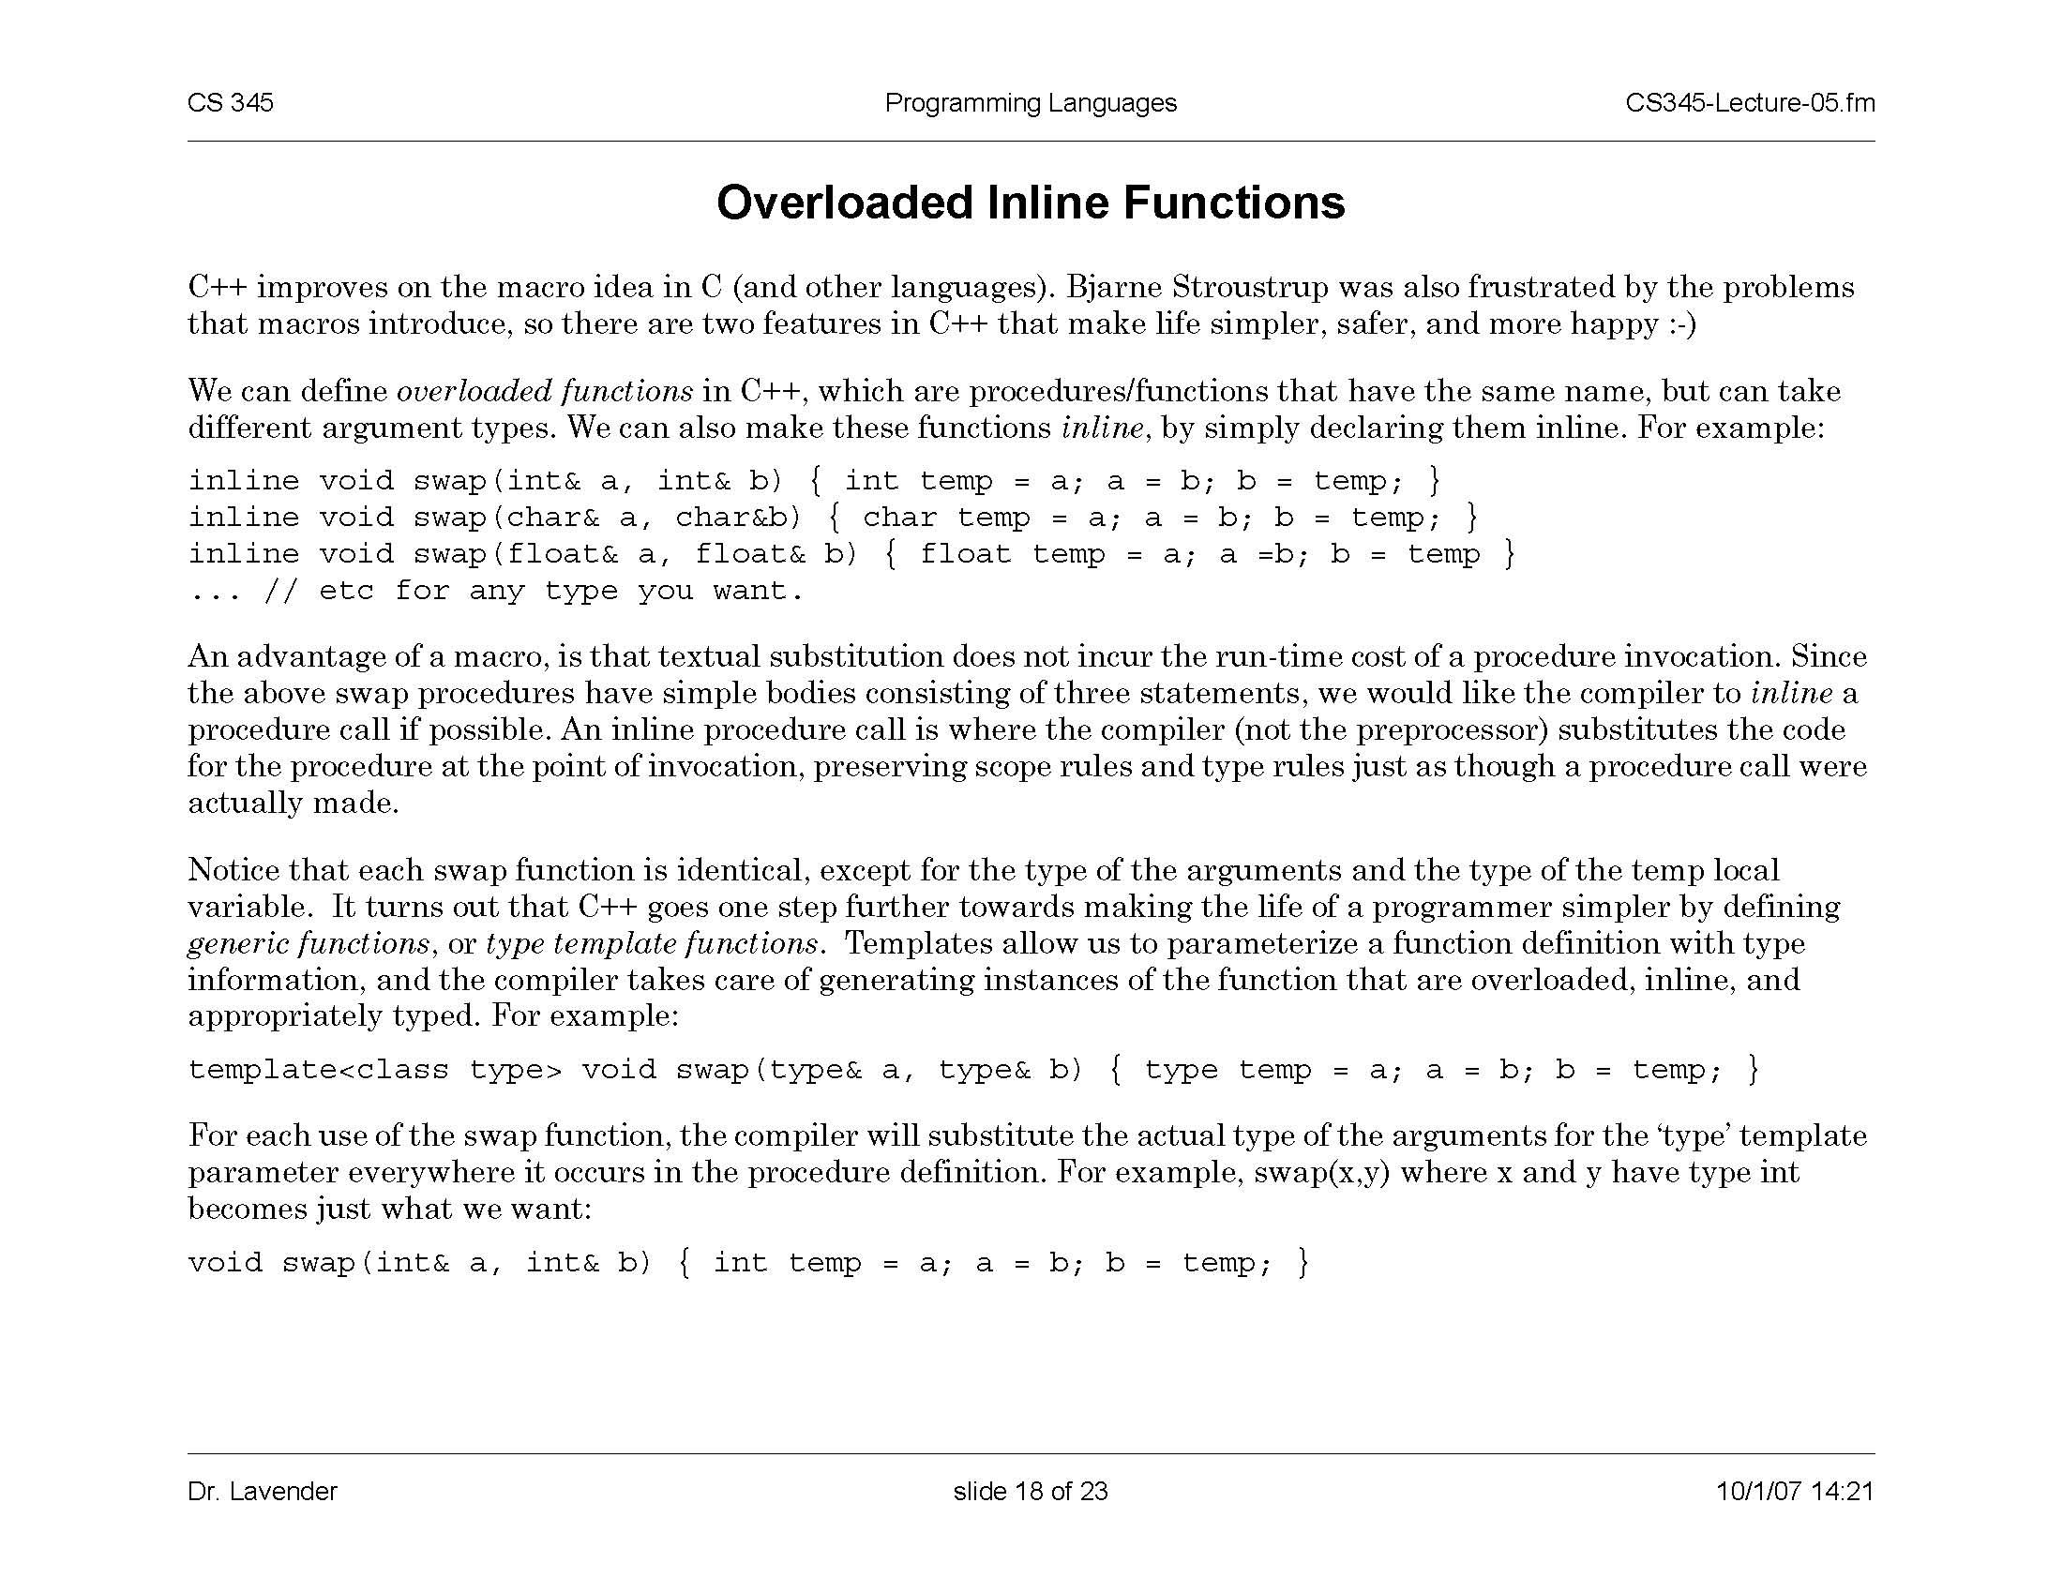
Function Overloading in C++
Functions that have the same name but can take arguments of different types
Tells compiler (not preprocessor) to substitute the code of
the function at the point of invocation
Saves the overhead of a procedure call
Preserves scope and type rules as if a function call was made
slide <number>

Slide 24
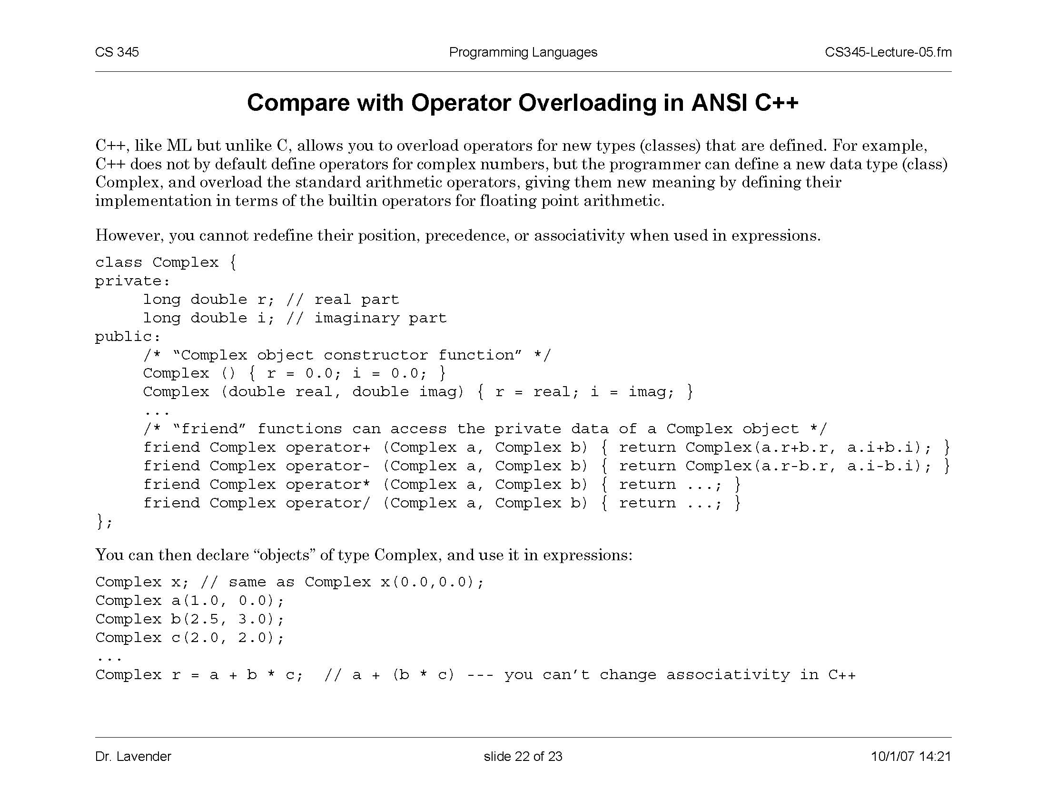
Overloading Infix Operators in C++
Cannot change position, associativity or precedence
slide <number>

Slide 25
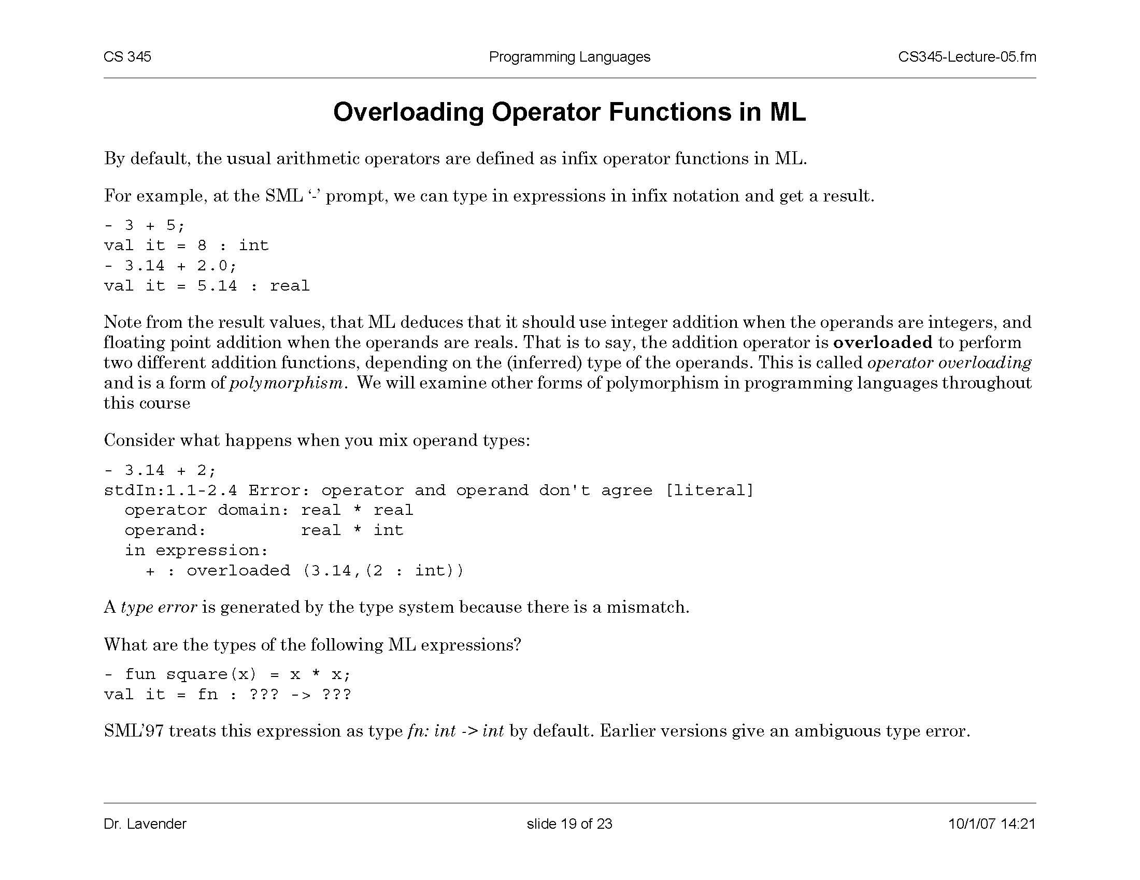
Operator Overloading in ML
ML infers which function to use from the type of the operands
slide <number>

Slide 26
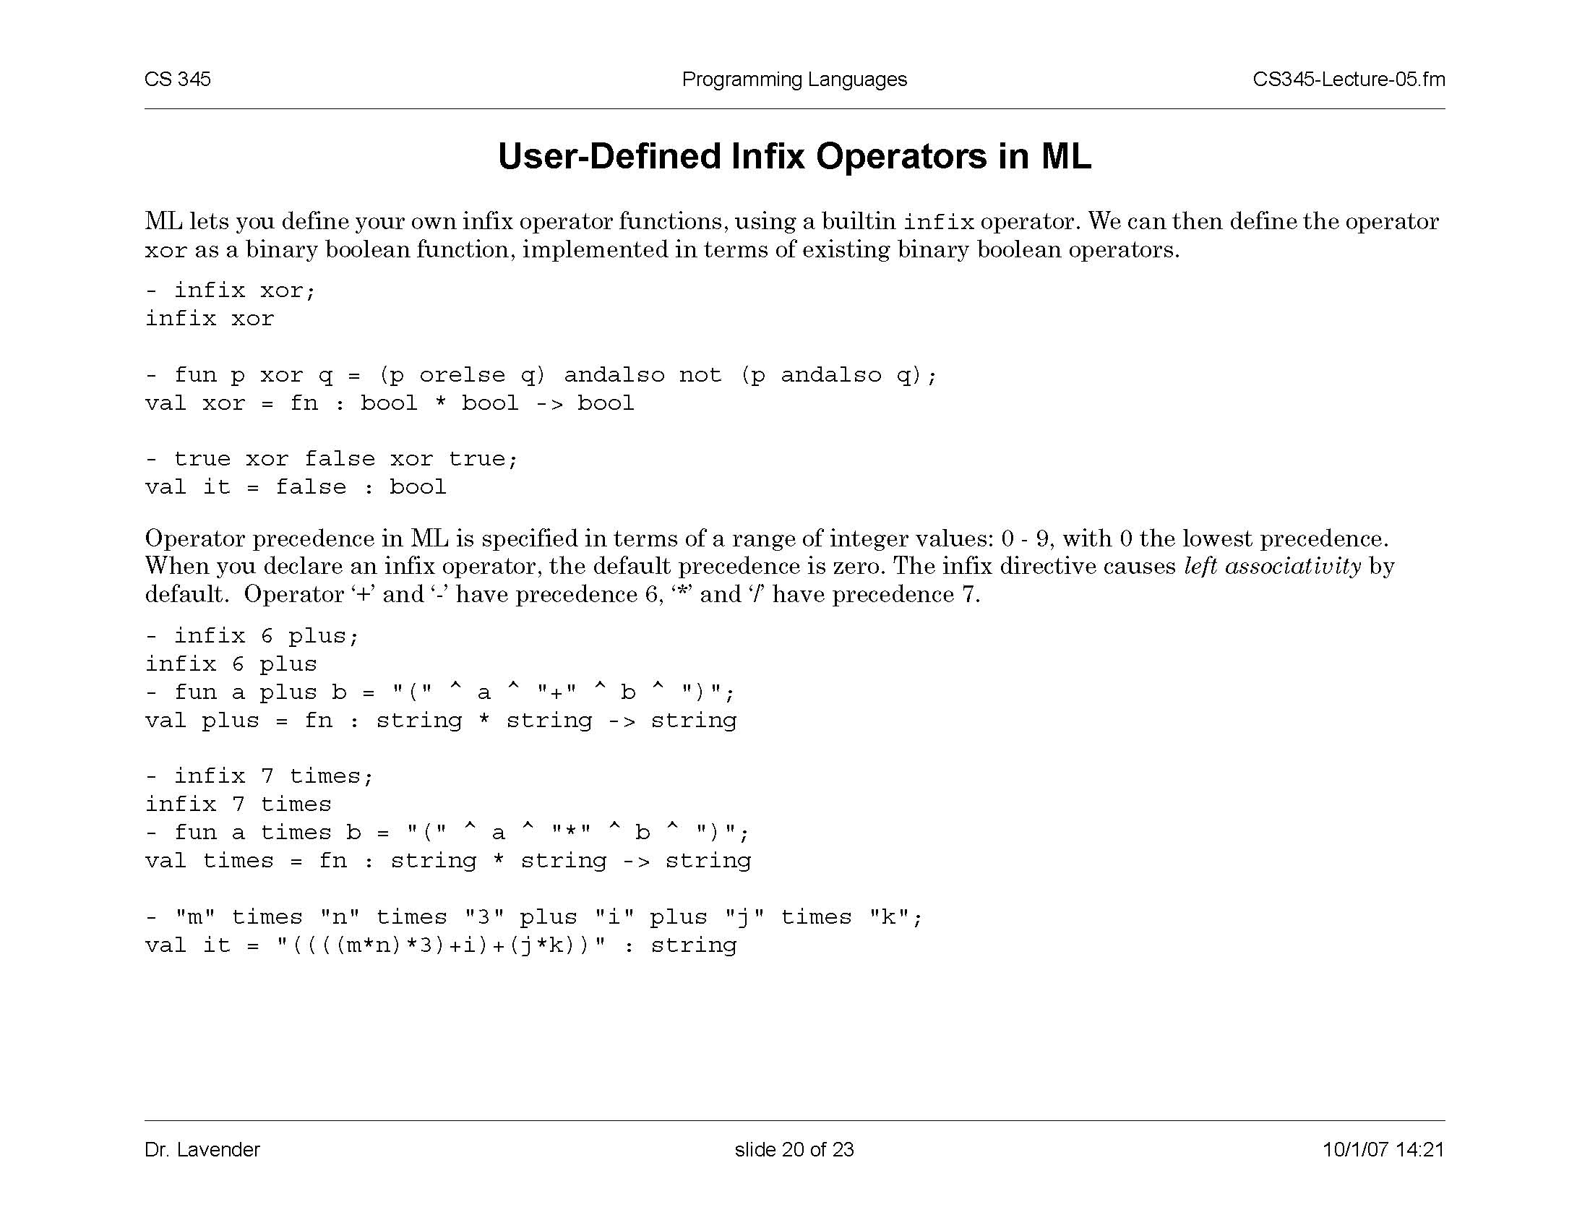
User-Defined Infix Operators in ML
  Precedence is specified by integer values 0-9
    0 = lowest precedence; left associativity (or else use infixr)
    nonfix turns infix function into a binary prefix function
slide <number>

Slide 27
Polymorphism and Generics
An operator or function is polymorphic if it can be applied to any one of several related types
  Enables code re-use!
Example: generic functions in C++
  Function operates in exactly the same way regardless of the type of its arguments
  For each use, compiler substitutes the actual type of the arguments for the ‘type’ template parameters
  This is an example of parametric polymorphism
slide <number>

Slide 28
Polymorphism vs. Overloading
Do you see the
difference?
Parametric polymorphism
  Single algorithm may be given many types
  Type variable may be replaced by any type
  f : t→t ⇒ f : int→int, f : bool→bool, ...
Overloading
  A single symbol may refer to more than one algorithm
  Each algorithm may have different type
  Choice of algorithm determined by type context
  Types of symbol may be arbitrarily different
  + has types int*int→int, real*real→real
slide <number>

Slide 29
Type Checking vs. Type Inference
Standard type checking
  int f(int x) { return x+1; };
  int g(int y) { return f(y+1)*2; };
  Look at the body of each function and use declared types of identifiers to check agreement
Type inference
  int f(int x) { return x+1; };
  int g(int y) { return f(y+1)*2; };
  Look at the code without type information and figure out what types could have been declared
ML is designed to make type inference tractable
slide <number>

Slide 30
Motivation
Types and type checking
  Type systems have improved steadily since Algol 60
  Important for modularity, compilation, reliability
Type inference
  Widely regarded as important language innovation
  ML type inference is an illustrative example of a
  flow-insensitive static analysis algorithm
    What does this mean?
slide <number>

Slide 31
ML Type Inference
Example
  - fun f(x) = 2+x;
  > val it = fn : int → int
How does this work?
  + has two types: int*int → int, real*real→real
  2 : int has only one type
  This implies + : int*int → int
  From context, need x: int
  Therefore f(x:int) = 2+x has type int → int
Overloaded + is unusual. Most ML symbols have unique type.
In many cases, unique type may be polymorphic.
slide <number>

Slide 32
How Does This Work?
Example
  - fun f(x) = 2+x;
  > val it = fn : int → int
How does this work?
Graph for f(x) = 2+x
fun
t→int
= int→int
Assign types to leaves
@
int (t = int)
@
x
Propagate to internal nodes and generate constraints
int→int
: t
+
2
: int
int → int → int
real → real→real
Solve by substitution
slide <number>

Slide 33
Application and Abstraction
@
: r (s = t→ r)
fun
: s → t
f
: s
x
: t
x
: s
e
: t
Application
  f must have function type domain→range
  Domain of f must be type of argument x
  Result type is range of f
Function expression
  Type is function type domain→range
  Domain is type of variable x
  Range is the type of function body e
slide <number>

Slide 34
Types with Type Variables
Example
  - fun f(g) = g(2);
  > val it = fn : (int → t) → t
How does this work?
Graph for f(g) = g(2)
s→t
= (int→t)→t
fun
t (s = int→t)
Assign types to leaves
@
Propagate to internal nodes and generate constraints
g
: s
2
: int
Solve by substitution
slide <number>

Slide 35
Using a Polymorphic Function
Function
  - fun f(g) = g(2);
  > val it = fn : (int → t) → t
Possible applications
  - fun add(x) = 2+x;
  > val it = fn : int → int
  - f(add);
  > val it = 4 : int
  - fun isEven(x) = ...;
  > val it = fn : int → bool
  - f(isEven);
  > val it = true : bool
slide <number>

Slide 36
Recognizing Type Errors
Function
  - fun f(g) = g(2);
  > val it = fn : (int → t) → t
Incorrect use
  - fun not(x) = if x then false else true;
  > val it = fn : bool → bool
  - f(not);
  Type error: cannot make bool → bool = int → t
slide <number>

Slide 37
Another Type Inference Example
Function definition
  - fun f(g,x) = g(g(x));
  > val it = fn : (t → t)*t → t
Type inference
Graph for f(g,x) = g(g(x))
s*t→v
= (v→v)*v→v
fun
Assign types to leaves
v (s = u→v)
@
Propagate to internal nodes and generate constraints
g
u (s = t→u)
: s
@
g
: s
x
: t
Solve by substitution
slide <number>

Slide 38
Polymorphic Datatypes
Datatype with type variable ’a is syntax for “type variable a”
  - datatype ‘a list = nil | cons of ‘a*(‘a list)
  > nil : ‘a list
  > cons : ‘a*(‘a list) → ‘a list
Polymorphic function
  - fun length nil = 0
  | length (cons(x,rest)) = 1 + length(rest)
  > length : ‘a list → int
Type inference
  Infer separate type for each clause
  Combine by making two types equal (if necessary)
slide <number>

Slide 39
Type Inference with Recursion
Second clause
  length(cons(x,rest)) = 1 + length(rest)
Type inference
  Assign types to leaves, including function name
  Proceed as usual
  Add constraint that type of function body is equal to the type of function name
‘a list→int = t
fun
@
@
@
@
cons
: ‘a*‘a list→‘a list
+
1
length
rest
: t
x
Tricky, isn’t it?
slide <number>

Slide 40
Type Inference Summary
Type of expression computed, not declared
  Does not require type declarations for variables
  Find most general type by solving constraints
  Leads to polymorphism
Static type checking without type specifications
  Idea can be applied to other program properties
Sometimes provides better error detection than type checking
  Type may indicate a programming error even if there is no type error (how?)
slide <number>

Slide 41
Costs of Type Inference
More difficult to identify program line that causes error
ML requires different syntax for values of different types
  integer: 3, real: 3.0
Complications with assignment took years to work out
slide <number>

Slide 42
Information From Type Inference
An interesting function on lists
  fun reverse (nil) = nil
  | reverse (x::lst) = reverse(lst);
Most general type
  reverse : ‘a list → ‘b list
What does this mean?
  Since reversing a list does not change its type, there must be an error in the definition of “reverse”
See Koenig paper on course website
slide <number>

Slide 43
Param. Polymorphism: ML vs. C++
ML polymorphic function
  Declaration has no type information
  Type inference: type expression with variables, then substitute for variables as needed
C++ function template
  Declaration gives type of function argument, result
  Place inside template to define type variables
  Function application: type checker does instantiation
  ML also has module system with explicit type parameters
slide <number>

Slide 44
Example: Swap Two Values
ML
  fun swap(x,y) =
  let val z = !x in x := !y; y := z end;
  val swap = fn : 'a ref * 'a ref -> unit
C++
  template <typename T>
  void swap(T& x, T& y){
  T tmp = x; x=y; y=tmp;
  }
Declarations look similar, but compiled very differently
slide <number>

Slide 45
Implementation
ML
  Swap is compiled into one function
  Typechecker determines how function can be used
C++
  Swap is compiled into linkable format
  Linker duplicates code for each type of use
Why the difference?
  ML reference cell is passed by pointer, local x is a pointer to value on heap
  C++ arguments passed by reference (pointer), but local x is on stack, size depends on type
slide <number>

Slide 46
Another Example
C++ polymorphic sort function
  template <typename T>
  void sort( int count, T * A[count] ) {
  for (int i=0; i<count-1; i++)
  for (int j=i+1; j<count-1; j++)
  if (A[j] < A[i]) swap(A[i],A[j]);
  }
What parts of implementation depend on type?
  Indexing into array
  Meaning and implementation of <
slide <number>

Slide 47
ML Overloading and Type Inference
Some predefined operators are overloaded
User-defined functions must have unique type
  - fun plus(x,y) = x+y;
  This is compiled to int or real function, not both
Why is a unique type needed?
  Need to compile code ⇒ need to know which +
  Efficiency of type inference
  Aside: general overloading is NP-complete
slide <number>

Slide 48
Summary
Types are important in modern languages
  Organize and document the program, prevent errors, provide important information to compiler
Type inference
  Determine best type for an expression, based on known information about symbols in the expression
Polymorphism
  Single algorithm (function) can have many types
Overloading
  Symbol with multiple meanings, resolved when program is compiled
slide <number>

